Slide 1
HEALTHCARE

Slide 2
GROUP DETAILS
S.No | Full Name | Email Address
1 | Gandam Pranay Kumar | pranayyash000@gmail.com
2 | Suravajjala Snehita | suravajjalasnehita2000@gmail.com
3 | Anyam Sahithi | anyamsahithi30@gmail.com
4 | Mule Soma Sundar Reddy | sundarreddymule06@gmail.com
5 | Smita Sunil Kesapure | smitakesapure33@gmail.com

Slide 3
KEY PERFORMANCE INDICATOR(KPI)
Excel dashboard
Percentage of Hospital Discharge by payer Source
Number of Patient Days by Payer Source
Hospital Baddebts and Charity care
Revenue Trend
Change in Net Patient Revenue by Payer Source
Tableau dashboard
Patient Days
Net Patient Revenue by Type of Hospitals
Total Discharge
City wise Count of Hospitals
Gross Inpatient and Outpatient Revenue over Time
Revenue Trend
Total net patient revenue
Financial Metrics
Net profit margin

Slide 4
Power BI Dashboard
Revenue trend
Net patient revenue by year
Total patient days by payer source
Total discharges by year
Count of available beds by type of hospital
Average length of stay by type of hospital
Capital expenditure by year
Inpatient and outpatient revenue by type of hospital
SQL QUERIES
Total discharge>=500 for type of control
sum of total discharge for type of control
city wise patient days where patient days is >=0

Slide 5
SUMMARY OF PROJECT
Introduction:
The healthcare analysis dashboard for 2016(Q4)-2020(Q2) provides a comprehensive overview of hospital performance, focusing on inpatient and outpatient outcomes, financial metrics, and resource utilization. This summary highlights the keyfindings, insights, and recommendations based on the data.
Objective:
The objective of our healthcare analysis dashboards is to enhance decision-making and operational efficiency by providing real-time insights into key performance metrics.
To create a comprehensive healthcare dashboard using Excel, Tableau, and Power BI for data-driven insights into financial and operational performance.
Key Findings:
Net Patient Revenue by Type of Hospitals
revenue trend
patients days
gross inpatient and outpatient
total discharges
Scope:
Analyzing financial data, utilization metrics, cost and revenue breakdowns, and operational efficiency.

Slide 6
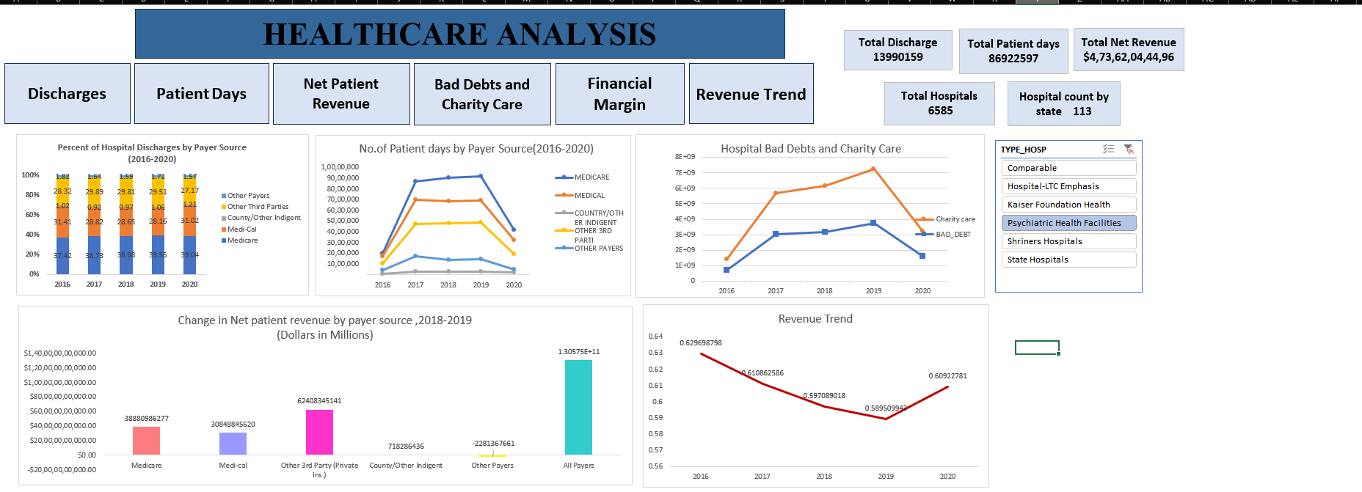
EXCEL DASHBOARD

Slide 7
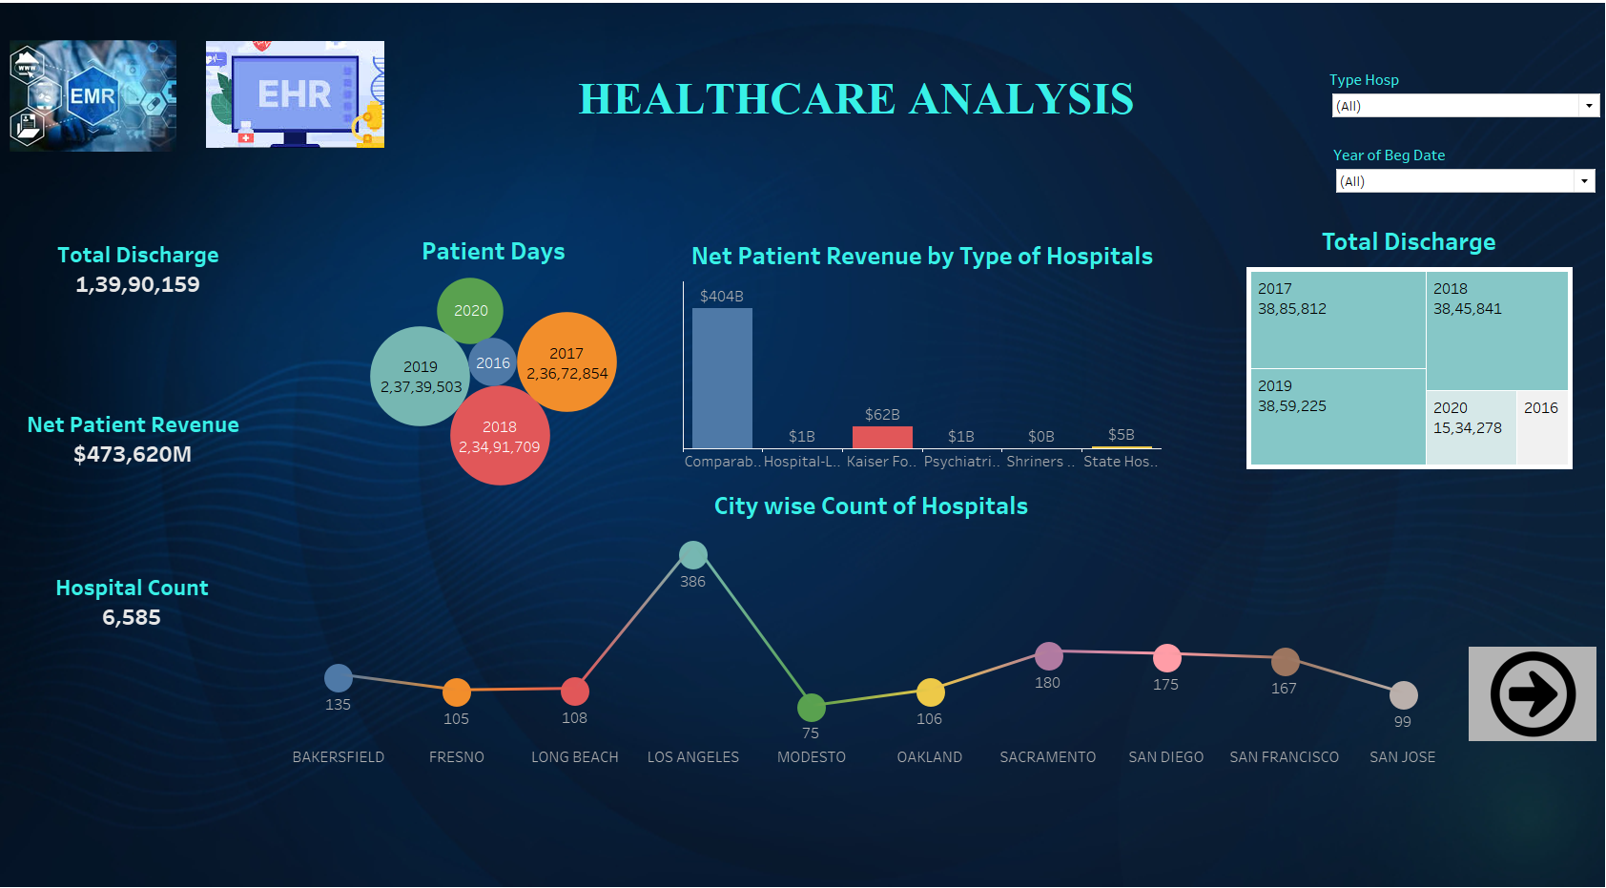
TABLEAU DASHBOARD

Slide 8
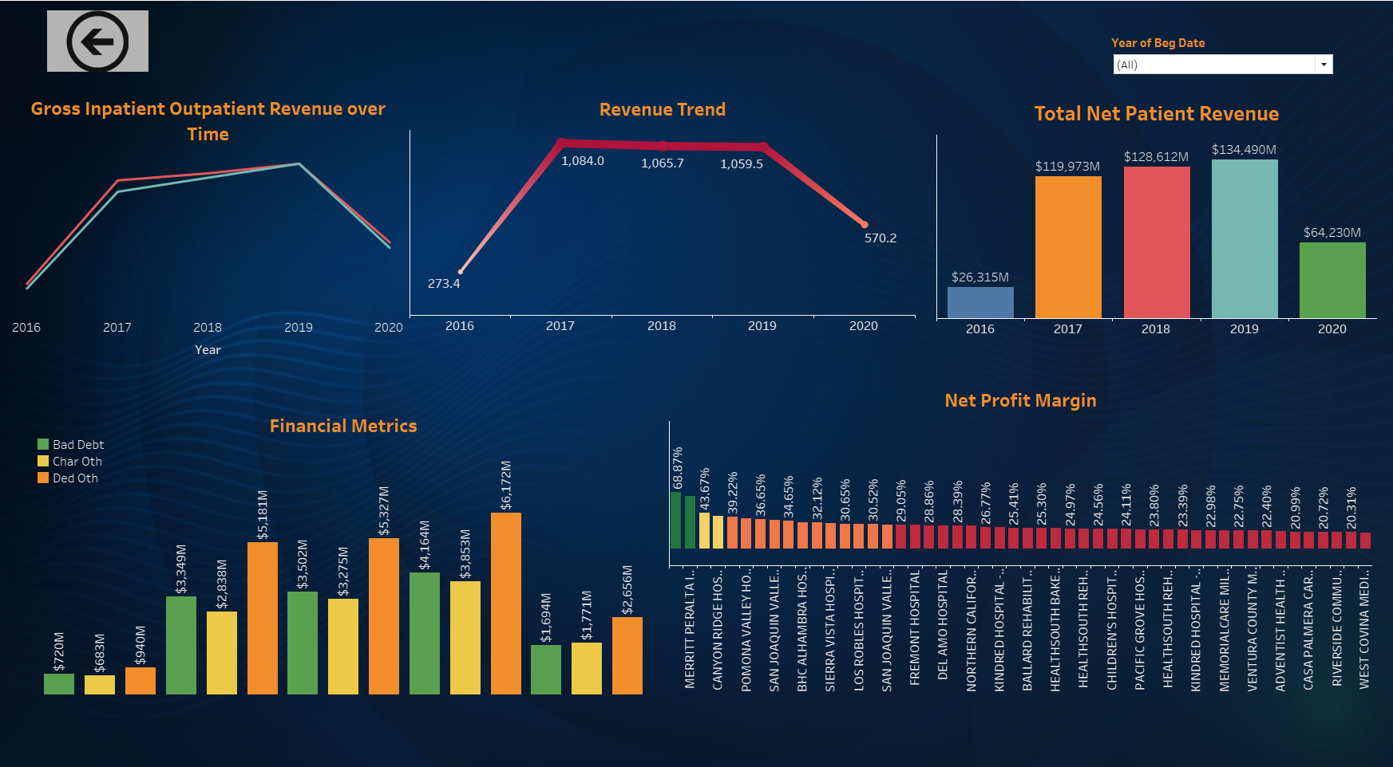

Slide 9
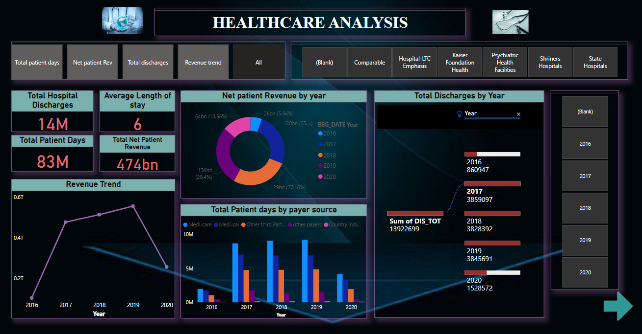
POWER BI DASHBOARD

Slide 10
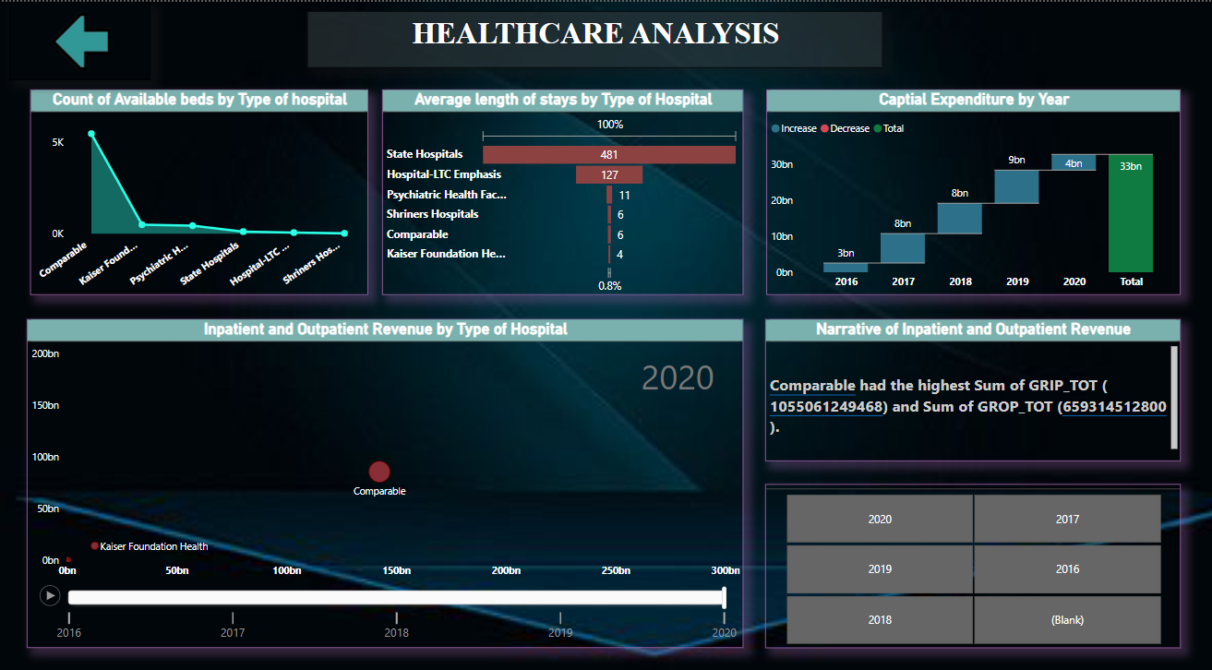

Slide 11
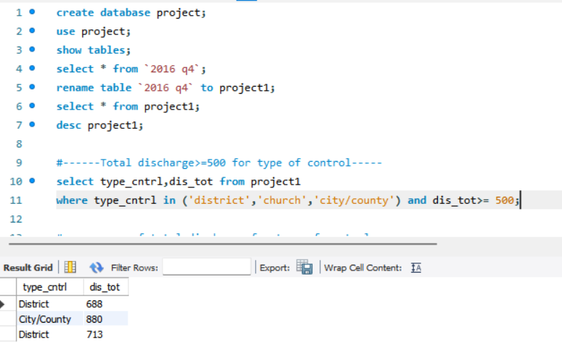
SQL QUERIES

Slide 12
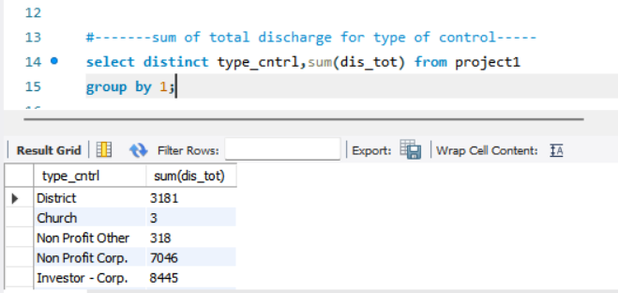
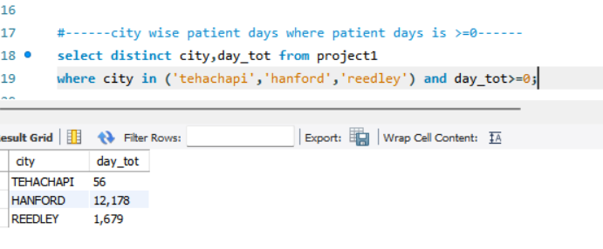

Slide 13
KEY INSIGHTS
Excel Dashboard:
Percentage of Hospital Discharge by Payer Source: This KPI helps in understanding which payer sources contribute most to hospital discharges.
Revenue Trend: A clear visualization of how revenue has changed over time, indicating periods of growth or decline.
Tableau Dashboard:
Patient Days: Insights into the number of patient days, providing an understanding of hospital utilization.
Net Patient Revenue by Type of Hospitals: Comparison of revenue generated by different types of hospitals, highlighting the most profitable ones.
Gross Inpatient and Outpatient Revenue over Time: Tracking revenue streams from inpatient and outpatient services, showing trends and seasonal variations.
Power BI Dashboard:
Average Length of Stay by Type of Hospital: This KPI is crucial for operational efficiency, indicating how long patients stay in different types of hospitals.
Capital Expenditure by Year: Understanding the investment in hospital infrastructure and its impact on services and outcomes.

Slide 14
CONCLUSION
The integration of Excel, Tableau, and Power BI dashboards provides a holistic view of healthcare data, combining detailed analysis with high-level summaries.The dashboards provide real-time insights into key performance metrics, enabling better decision-making.By analyzing financial data and utilization metrics, hospitals can identify areas for improvement .
Tracking revenue trends and financial metrics helps in understanding the financial health of the hospitals and identifying profitable areas.These insights and KPIs will provide a clear and comprehensive overview of the healthcare analysis project.

Slide 15


